Slide 1
Psalms
Lesson 7
Your Mercy Reaches unto the Heavens

Slide 2

Memory Text
Psalm 57:9-10 NKJV
I will praise You, O Lord, among the peoples; I will sing to You among the nations. ¹⁰ For Your mercy reaches unto the heavens, And Your truth unto the clouds.
Reading the first two lines of this psalm, what kind of poetic parallelism is the psalmist using here.
If the first two phrases are synonymous, what would you expect for the second two?
Notes:
B2:
1. You may recall in the past we have noted the difference between Hebrew poetry and English poetry.
2. In English poetry we match the rhythm and try to rhyme the ending words of each phrase.
3. In Hebrew poetry, they write in parallelisms, where the second phrase is parallel to the first.
4. And we have noted that there are at least four different types of parallelisms.
5. First, there are synonymous parallelisms in which the second phrase conveys the same idea as the first but in different words.
6. Second, there are antithetical parallelisms where the second phrase contrasts with the first and gives the flip side of the idea of the first.
7. Third, there are synthetic parallelisms where the second phrase adds to and builds on the first.
8. And finally, there are climatic parallelisms where the poetry builds to a climax or a summary at the end.
9. Of these four types, what do we have here in Psalm 57?
10. If we look at the first two phrases, they are clearly synonymous. [Read again]
11. They convey the same idea, but using different words: praise is synonymous with sing and peoples is synonymous with nations.
12. One of the benefits of synonymous parallelism is that you get two chances to figure out what the psalmist is saying.
13. So here the first two phrases declare that the psalmist desires to sing the praises of the Lord God in public, and, not just in Israel, but among the heathen.
B3:
1. We would expect synonymous there as well.
2. Is that what we see? [Read second two again]
3. So here we see that heavens and clouds are synonymous.
4. And so we would expect mercy and truth to be synonymous too.
5. But the similarity between mercy and truth is not so obvious, at least to me.
6. So this should send us back to the original language with the question, did the translators pick the best meanings of these Hebrew words in the KJV and the NKJV.
7. If we look up the Hebrew word translated “mercy” it is ḥeseḏ (kheh’-sed).
8. In Sunday’s lesson, our author defines that word for us as “steadfast love.”
9. The four most frequent translations in the KJV are “mercy, kindness, lovingkindness, and goodness.”
10. Now let’s look at the word translated truth.
11. In the Hebrew it is ĕmeṯ, (eh'-meth).
12. It has meanings of reliability, stability, faithfulness, and truth.
13. So let’s say we go with “steadfast love” for “hesed” and “faithfulness” for “emet.”
14. Then verse 10 become: “For Your steadfast love reaches unto the heavens, And your faithfulness unto the clouds.”
15. Does that sound a little more synonymous that mercy and truth?
16. God’s steadfast love is synonymous with His faithfulness.
17. His love is constant; it will not let us go; God is love, and He changes not.
18. We can always depend on His steadfast faithful love for us.
19. This is picked up in some of the more modern translations.
Psalm 57:10 ESV - For your steadfast love is great to the heavens, your faithfulness to the clouds.
Psalm 57:10 NIV - For great is your love, reaching to the heavens; your faithfulness reaches to the skies.
Psalm 57:10 NLT - For your unfailing love is as high as the heavens. Your faithfulness reaches to the clouds.
And perhaps this psalm can remind us of one of our own great hymns
Great is Thy Faithfulness (#100)
Great is Thy faithfulness, O God my Father,
There is no shadow of turning with Thee,
Thou changest not, Thy compassions they fail not,
As Thou hast been, Thou forever wilt be.
Great is Thy faithfulness, Great is Thy faithfulness,
Morning by morning new mercies I see,
All I have needed Thy hand hast provided,
Great is Thy faithfulness, Lord unto me!

Slide 3
Overview
The psalms in our lesson this week point to a God of steadfast love for His people, one who is compassionate and merciful, who reconciles us to Himself by forgiving all our sins and healing our brokenness. Such a God deserves our highest praise, our complete surrender, our undivided love, and our best obedience.
  It Endures Forever
  A Clean Heart
  Majestic and merciful
  Bless the Lord
  Summary

Slide 4
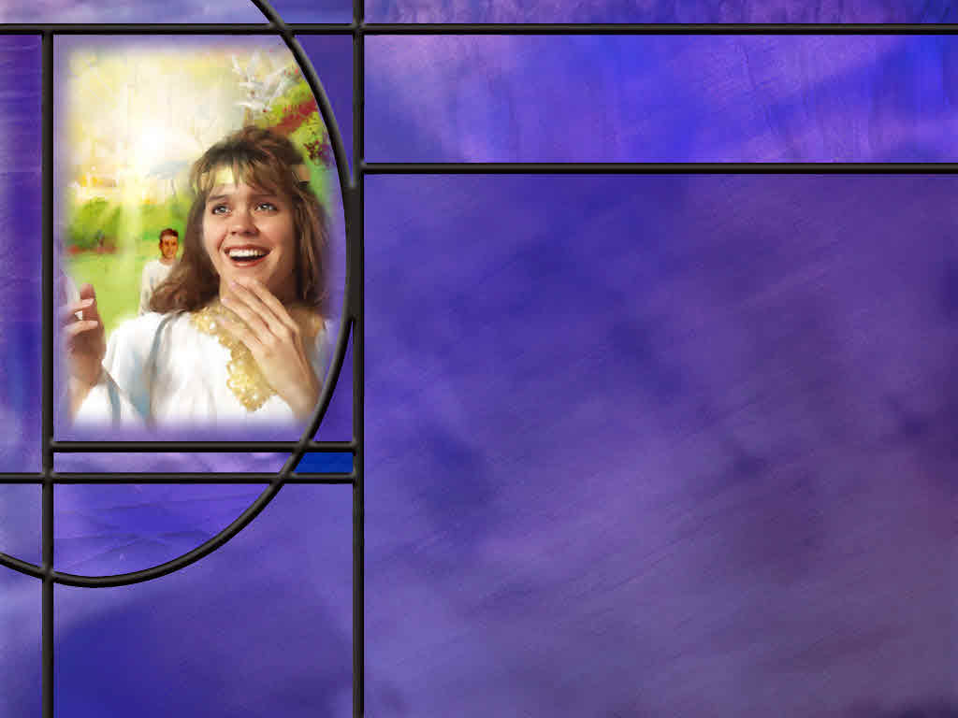
It Endures Forever
How does the writer of Psalm 136 make sure we get the point about God’s character of love? (Ps 136:1-3,26)
What actions of the Lord does the psalmist point to that indicate His steadfast love for His people? [Reasons for Thanksgiving]
Notes:
B1:
[See notes on linked slide.]
B2:
[See notes on linked slide.]

Slide 5
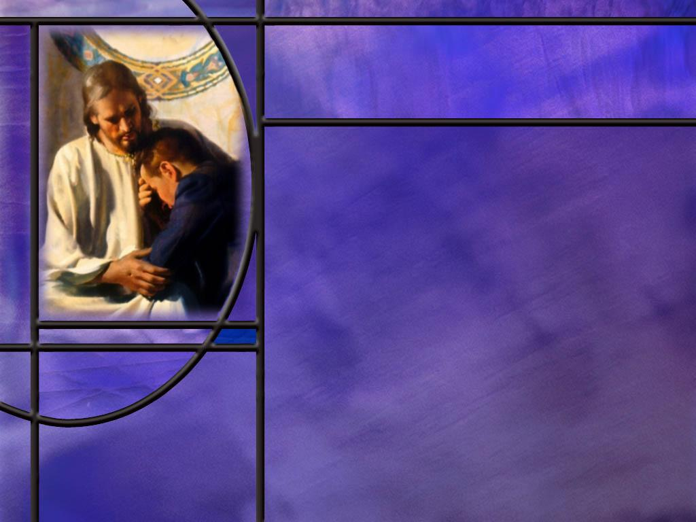
A Clean Heart
What was the cry of David’s heart when the Holy Spirit convicted him of sin? (Ps 51:1-2,7,10)
What does David write about sacrifices in Ps 51:16-17?
Where does the psalmist who wrote Ps 130 begin his cry to the Lord? (Ps 130:1-3)
What does the psalmist remember that pulls him out of the depths? (Ps 130:4)
Where does the assurance of God’s forgiveness lead the psalmist? (Ps 130:5-8)
Notes:
B1:
[See notes on linked slide.]
B2:
[See notes on linked slide.]
B3:
[See notes on linked slide.]
B4:
[See notes on linked slide.]
B5:
[See notes on linked slide.]

Slide 6
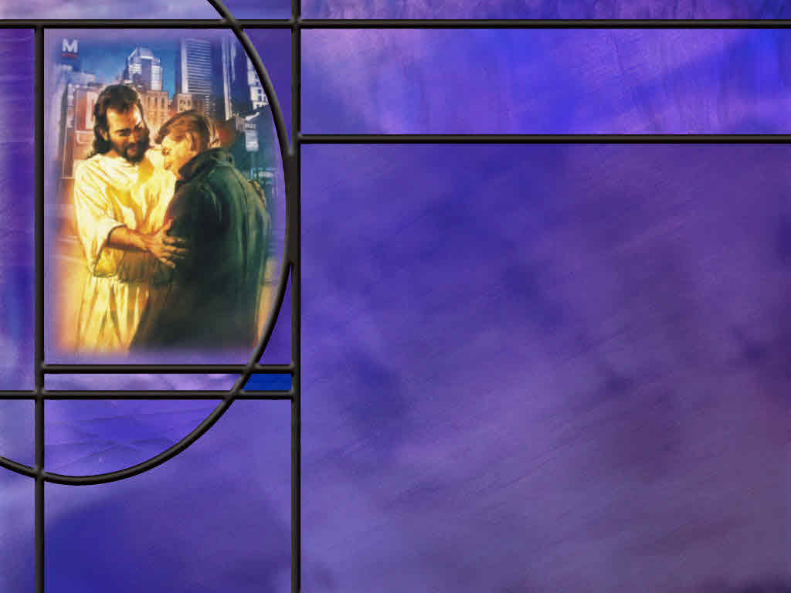
Majestic and Merciful
How does Ps 113 describe both the transcendence and imminence of God?
Notes:
B1:
[See notes on linked slide.]

Slide 7
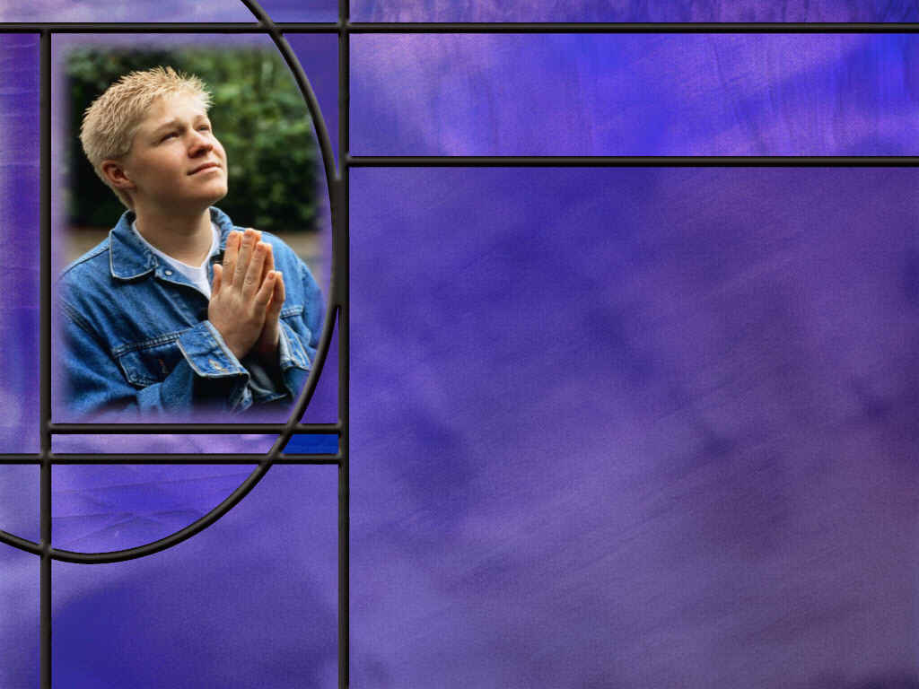
Bless the Lord
How does David begin this wonderful psalm of praise? (Ps 103:1-5)
While this psalm starts with a focus on God’s blessing of individuals, how does it end? (Ps 103:19-22)
What memorable and beloved verses express the theme of this psalm? (Ps 103:8,11-12)
Notes:
B1:
[See notes on linked slide.]
B2:
[See notes on linked slide.]
B3:
[See notes on linked slide.]

Slide 8

Summary
The psalms in our study this week paint a beautiful portrait of a loving God.
These psalms often use the Hebrew word “hesed” which can be translated as steadfast love, unfailing love, faithful love, lovingkindness, or mercy to describe God’s goodness toward us.
The refrain of Ps 136 repeats the truth in each of 26 verses that “His steadfast love endures forever.”
This theme is picked up in the NT with the Greek word agape to describe a love of God for this world that moved Him to give His only begotten Son.
So also in our psalms, the steadfast love of God moves Him to be gracious to those who fear Him.

Slide 9
Summary
In Psalm 51, David bares his soul before the Lord and before us, with a beautiful prayer of confession, repentance, asking for forgiveness and restoration so that he might again experience the joy of the Lord and the power of the Spirit in his life.
This can be a model prayer for us as we acknowledge our sin and ask for forgiveness.
If God can forgive David for his sins, surely He can forgive ours as well.
The psalmist who penned Psalm 130 started his cry to God out of the depths of darkness and despair but found his way out in only one verse.
His despairing thought was if God kept a record of our sins, who could stand?

Slide 10
Summary
“But with You there is forgiveness” is the truth that gave him hope.
It is that same truth that gives us hope as well. Our God is a forgiving God. He has sent His Son to bear our sins and give us eternal life instead of eternal death.
In Psalm 103, David calls all of creation to Bless the Lord, to praise and worship Him for all the ways He has blessed us.
These blessings come from a God he describes as “merciful and gracious, slow to anger and abounding in steadfast love.” and include most importantly, removing our transgressions as far as the east is from the west.
Will you heed David’s call this week to “Bless the Lord O my soul,” for His steadfast love endures forever?

Slide 12
Psalm 136:1-3, 26 ESV
Give thanks to the LORD, for he is good, for his steadfast love endures forever. 2 Give thanks to the God of gods, for his steadfast love endures forever. 3 Give thanks to the Lord of lords, for his steadfast love endures forever; ... 26 Give thanks to the God of heaven, for his steadfast love endures forever. [R]
Notes:
1. Here we have the first three verses and the last verse of Ps 136.
2. It is like a responsive reading but put to music.
3. You can imagine the soloist singing the first line of each verse and the choir responding with the second line: “His steadfast love endures forever.”
4. And, as we mentioned in the introduction, the Hebrew here is “hesed” which can also be translated, His mercy, His lovingkindness, His love, His unfailing love, endures forever.
5. So 26 times in this one psalm, we are reminded of the love of God for us.
Q1: What does this refrain tell you about the character of God?
1. First, it tells us that God is love.
2. We see that clearly in John’s first epistle where he writes:
1 John 4:8 KJV - He that loveth not knoweth not God; for God is love.
3. This is God’s greatest relational attribute.
4. God does not love us because we are lovable; He loves us because He is loving.
5. He loves us in spite of the fact that we are sinners.
6. “Amazing love, how could it be, that Thou my God, shouldst die for me.” (Hymn 198)
7. His love for His creatures is steadfast; it is unfailing; it is always there.
8. Second, it tells us that God’s love endures forever.
9. God’s character does not change: He is the same yesterday, today, and forever.
Malachi 3:6 KJV - For I am the LORD, I change not; therefore ye sons of Jacob are not consumed.
10. So if God’s character is fixed and the moral law of God is a transcript of His character, what does that say about the law of God?
11. His law is as fixed as His character.
12. God’s law has never changed and it never will.
Q2: What does it mean to you that His love endures forever?
1. For those who are in Christ, His love will never end.
2. It will endure through the ceaseless ages of eternity.
3. And His people will be the recipients of that love as He dwells with us in the eternal kingdom of God.
4. In the great love chapter, Paul wrote:
1 Corinthians 13:13 KJV - 13 And now abideth faith, hope, love charity, these three; but the greatest of these is love charity.
5. Someday our faith will be sight, our hope will be a reality, but love never fails.
6. It will continue for all eternity as this psalm declares time and again.

Slide 13
Reasons to Give Thanks unto the Lord
He does great wonders
Made the heavens, earth, sun, moon, stars,
Brought Israel out of Egypt,
Divided the Red Sea,
Drowned Pharaoh and his army.
Led His people through the wilderness,
Defeated kings and armies in the Promised Land.
Gave their land to His people Israel,
Remembers us in our difficulties,
Rescues us from our foes,
Gives food to all flesh [R]
Notes:
1. All these are reasons why the psalmist calls us to give thanks to the LORD.
Q1: How many of these reasons are relevant for you today as reasons to give thanks to God?
1. Certainly God’s great creative genius as seen in the creation of the universe, of this world, and all living things is reason to give thanks.
2. Probably the deliverance of the Israelites from Egypt is not as directly relevant to us as to the Hebrew people, but these are our spiritual ancestors.
3. It is through these people that our Messiah has come to die for our sins, so we can also appreciate the fact that, in Christ, we are Abrahams spiritual seed.
4. We can also remember that God’s deliverance of the Israelites from Egypt is a type of Christ’s deliverance of us from sin.
5. We too have a promised land to which our Savior is leading us.
6. God remembers us in our difficulties, rescues us from our foes, particularly the devil our greatest foe, and provides the necessities of life.
7. We can see relevance in all of these evidences of God’s steadfast love for His people.
8. So let’s join the psalmist and “Give thanks to the God of heaven, for His steadfast love endures forever.”

Slide 14
Psalm 51:1-2, 7, 10 ESV
Have mercy on me, O God, according to your steadfast love; according to your abundant mercy blot out my transgressions. 2 Wash me thoroughly from my iniquity, and cleanse me from my sin! ... 7 Purge me with hyssop, and I shall be clean; wash me, and I shall be whiter than snow. ... 10 Create in me a clean heart, O God, and renew a right spirit within me. [R]
Notes:
Q1: Who wrote Psalm 51, and why did he write it?
1. Many of the psalms have an introductory note identifying the author and the occasion for which the psalm was written.
2. Psalm 51 has this note before verse 1: “To the Chief musician. A Psalm of David when Nathan the prophet went to him after he had gone in to Bathsheba.”
3. This is David’s Psalm of repentance for his sins on this particular occasion.
Q2: While this is perhaps the most famous psalm of repentance, what other psalms are prayers of repentance?
1. There is a whole group of psalms referred to as the penitential psalms where the theme is repentance or sorrow for sin.
2. The Penitential Psalms include: Psalm 6, 25, 32, 38, 39, 40, 51, 102, 130, a total of 9 psalms.
3. The author of the first seven of these psalms was David.
4. So David had many sins to confess.
5. And if God can forgive David of his sins, what about us?
6. We can be confident that God will hear our confession and repentance too.
Q3. On what character traits of God does David rely as he approaches God for forgiveness?
1. He knows he can call on God for mercy because of two things: God’s steadfast love (again the Hebrew “hesed”) and God’s abundant mercy or compassion.
Q4: What words does David use to describe his sin in verses 1 and 2?
1. v.2 Blot out my transgressions.
2. v.3 wash me from my iniquity.
3. v.4 cleanse me from my sin.
4. These are the three commonly used OT words to refer to the totality of sin.
5. These same words were used by the Lord in describing His forgiveness to Moses:
Exodus 34:6-7 ESV - 6 The LORD passed before him and proclaimed, "The LORD, the LORD, a God merciful and gracious, slow to anger, and abounding in steadfast love and faithfulness, 7 keeping steadfast love for thousands, forgiving iniquity and transgression and sin, but who will by no means clear the guilty,
6. Transgression is rebellion against God: deliberately choosing disobedience.
7. Iniquity is the inner twistedness, our fallenness, our propensity to disobey.
8. Sin is missing the mark and failing to live up to God’s law and His will.
9. So David is here praying for a complete cleansing.
Q5: Why does David ask to be purged with hyssop?
1. It could be a reference to the sacrificial blood.
2. At the Passover, the angel instructed the Israelites to use hyssop to apply the blood of the Passover lamb to the doorposts of their homes.
3. That Passover lamb would point to Jesus the Lamb of God who takes away the sins of the world.
4. So here it appears that David understood the principle of Substitutionary Atonement.
5. The blood of the Substitute purged the sins of the guilty sinner.

Slide 15
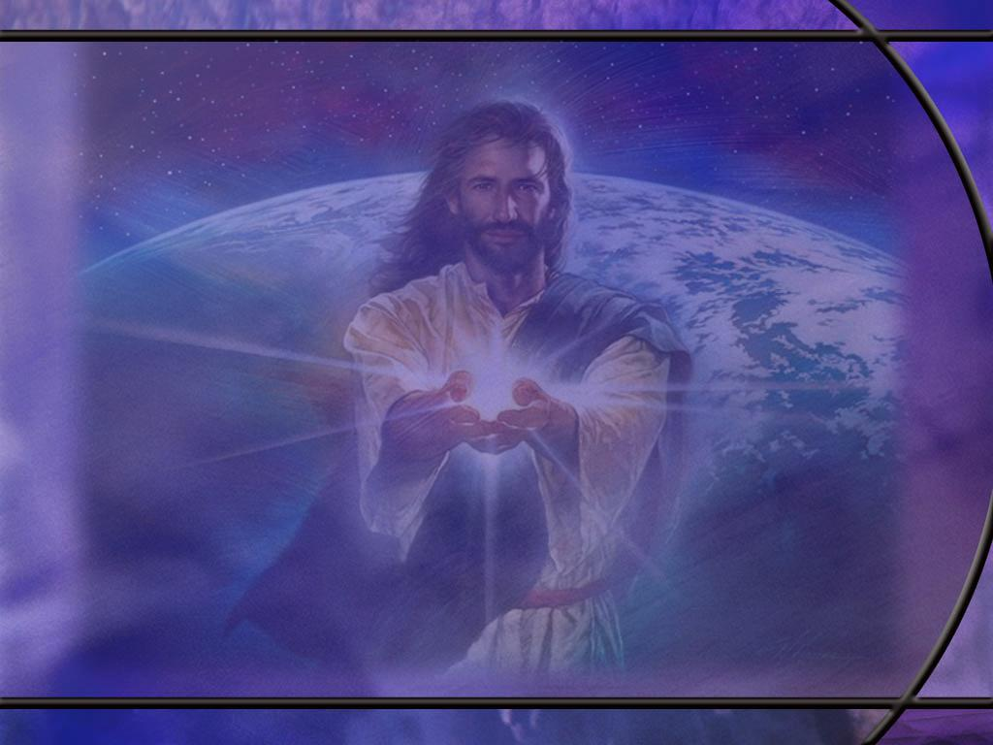
Psalm 51:16-17 ESV
For you will not delight in sacrifice, or I would give it; you will not be pleased with a burnt offering. ¹⁷ The sacrifices of God are a broken spirit; a broken and contrite heart, O God, you will not despise. [R]
Notes:
Q1: What does David recognize about the blood of bulls and goats?
1. David was rich enough to offer hundreds of sacrifices at the temple.
2. But he recognized that the blood of bulls and goats do not take away sin.
3. The sacrifices that God is looking for when we sin are a broken spirit and a contrite heart.
4. He is looking for us to acknowledge our sin, take responsibility for it, confess it, and ask for forgiveness.
(In fact, there is indication that the sanctuary service was only for unintentional sins, not premeditated sins of rebellion and intentional disobedience.)
5. The sanctuary was a teaching tool teaching the truth that God will deal with sin through the principle of “substitutionary atonement.”
6. The sacrifices pointed forward to the Lamb of God who really would atone for sin.
7. But true forgiveness comes from repentance, confession, and faith in the love and grace and goodness of God to forgive.

Slide 16
Psalm 130:1-3 NIV
Out of the depths I cry to you, LORD; ² Lord, hear my voice. Let your ears be attentive to my cry for mercy. ³ If you, LORD, kept a record of sins, Lord, who could stand? [R]
Notes:
Q1: Where is the psalmist when he cries out to the Lord?
1. He is in the depths, and it is from there that he cries out to the LORD, Yahweh.
2. It doesn’t say what his circumstances are, but the depths are not a good place.
3. Perhaps the depths of despair, of depression, of disillusionment, of discouragement.
4. Perhaps he feels he is sinking deep in sin alone and lost.
5. Psalm 69 opens with similar feelings:
Psalm 69:1-2 NIV - 1 Save me, O God, for the waters have come up to my neck. 2 I sink in the miry depths, where there is no foothold. I have come into the deep waters; the floods engulf me.
Q2: How does verse 3 give us a better idea of the depths from which he cries out?
“Lord, if you keep a record of sins, who could stand?”
Lord, if you hold my sins against me, I’m a goner!
And by the way, so is everyone else.
There is none righteous, no not one.
For all have sinned and come short of the glory of God.
We all stand before You guilty.
We are all sinking in the quagmire of sin and guilt; none of us can stand.

Slide 17
Psalm 130:4 NIV
But with you there is forgiveness, so that we can, with reverence, serve you. [R]
Notes:
Q1: What little word here changes his whole perspective?
1. This little word “but” changes everything.
2. And we often find it in Hebrew poetry when we have antithetical parallelisms.
3. The second phrase then gives the flip side of the first.
4. So if we look at verses 3 and 4 together as parallel phrases:
5. If you, LORD, kept a record of sins, Lord, who could stand? (That’s the bad news)
6. But with you there is forgiveness, so that we can, with reverence, serve you. (That’s the good news.)
7. So verse 4 is the flip side of verse 3.
8. So here is the antidote for the cry from the depths in verse 1.
9. Take a moment and let this good news sink in.
10. “But with You there is forgiveness.”
11. Is that good news? That’s the gospel!!!
12. James Montgomery Boice has written this in his commentary on this psalm:
“Other people may not forgive you. Your husband or wife may not forgive you if you have wronged him or her. Your children may not forgive you. Your coworkers many not forgive you. You may not even be able to forgive yourself. There is One who will and that one is God. Write that down where you can see and reflect on it often. Our God is a forgiving God. He will not remember our transgressions against us. He will remove them as far as the east is from the west -- if we ask Him for mercy. … God’s forgiveness is inclusive. Verse 4 does not say there is forgiveness for this sin or that. While leaving out some other sin, perhaps the one you have committed. It sets no limits at all. It says “There is forgiveness.” Forgiveness for any sin by anybody.”
1 John 1:7 ESV - …and the blood of Jesus his Son cleanses us from all sin.

Slide 18
Psalm 130:5-8 NIV
I wait for the LORD, my whole being waits, and in his word I put my hope. ⁶ I wait for the Lord more than watchmen wait for the morning, more than watchmen wait for the morning. ⁷ Israel, put your hope in the LORD, for with the LORD is unfailing love and with him is full redemption. ⁸ He himself will redeem Israel from all their sins. [R]
Notes:
Q1: What does it mean to wait for the Lord?
1. It means to look forward to His presence.
2. He uses the analogy of a watchman waiting for the morning.
3. When the morning comes, the night is over, the new day has begun.
4. There is joy and peace and laughter and love.
5. Now that our sins are forgiven, we can walk in the light with our Lord and Savior who has redeemed us from darkness and death.
6. There is a close connection in these verses between waiting and hope.
7. Hope is a confident expectation that God will fulfill His promises.
8. We look for the blessed hope: the promise of Jesus to return for us.
9. The psalmist waits and puts his hope in the word of God and His promises.
10. He is waiting anxiously looking forward to walking in the light with His Savior and Lord.
Q2: As opposed to the depths where he started, where does the psalmist end up?
1. He ends up confident in the Lord’s unfailing love and full redemption.
2. So confident, in fact, that he is calling for his countrymen to put their hope in the LORD as well.
3. Because He alone can redeem Israel from all their sins.
4. The psalmist starts in the darkness, but he ends in the light.
5. He starts in despair but he ends in hope.
6. He starts unable to stand, but in the Lord, he find forgiveness.
7. That can be our experience as well.
8. This is the gospel: Christ died for our sins, and He alone can provide full redemption.

Slide 19
Psalm 113:4-9 NIV
The LORD is exalted over all the nations, his glory above the heavens. 5 Who is like the LORD our God, the One who sits enthroned on high, 6 who stoops down to look on the heavens and the earth? 7 He raises the poor from the dust and lifts the needy from the ash heap; 8 he seats them with princes, with the princes of his people. 9 He settles the childless woman in her home as a happy mother of children. Praise the LORD. [R]
Notes:
Q1: What characteristics of God do we see described in verses 4-6?
1. These verses speak of the transcendence of God.
2. God is above and beyond the heavens; He transcends the limitations of our physical existence.
3. He is over all the nations; He has to stoop down to look at the heavens and the earth.
4. The transcendence of God speaks of His independence of the creation.
5. He is creator of all, owner of all, ruler of all.
Q2: What characteristics of God do we see described in verses 7-9?
1. These verses speak of the immanence of God.
2. He comes close to every one of us.
3. He desires to dwell with us.
4. He wants a relationship with us.
5. Although we are poor and needy, childless and sad, He lifts us out of the ash heap.
6. He is the God who loves us and wants to be our forever Friend.
7. God is both transcendent and immanent.

Slide 20
Psalm 103:1-5 ESV
Bless the LORD, O my soul, and all that is within me, bless his holy name! ² Bless the LORD, O my soul, and forget not all his benefits, ³ who forgives all your iniquity, who heals all your diseases, ⁴ who redeems your life from the pit, who crowns you with steadfast love and mercy, ⁵ who satisfies you with good so that your youth is renewed like the eagle’s. [R]
Notes:
Q1: What does it mean to bless the Lord?
1. We are familiar with how the Lord blesses us, but how do we bless the Lord?
2. The Hebrew word for bless is “barak.”
3. When God blesses a man He endows him with good gifts.
4. It might be wisdom, good health, a plentiful harvest, long life, forgiveness, or salvation by grace.
5. When a man blesses God, he acknowledges God as the source of the good gifts he has received and praises Him and worships Him for His goodness.
6. David goes on and on in this psalm listing all the blessings we receive from God and calling us to praise and worship Him in return.
7. Notice that in these opening verses, David is focused on how the Lord blesses us as individuals.
8. Of particular importance here is that He is the one who forgives all your iniquities.
9. These blessings that we receive all stem from God’s steadfast love and mercy toward us.

Slide 21
Psalm 103:19-22 ESV
The LORD has established his throne in the heavens, and his kingdom rules over all. ²⁰ Bless the LORD, O you his angels, you mighty ones who do his word, obeying the voice of his word! ²¹ Bless the LORD, all his hosts, his ministers, who do his will! ²² Bless the LORD, all his works, in all places of his dominion. Bless the LORD, O my soul! [R]
Notes:
Q1: Here at the end of the psalm, who is David calling to bless the Lord?
1. He is calling the whole universe and beyond.
2. He is calling the angels in the spiritual realm.
3. He is calling all of his creation in all places of His dominion.
4. Let the whole universe and the whole realm of angelic beings bless the Lord.
5. And finally, “Bless the Lord, O my Soul!”
6. In verses 6-18, David expands the focus of God’s blessing from the individual in verses 1-5 to Israel in the past (vs. 6-10) to Israel in the present (vs. 11-14) to humanity at large (vs. 15-18).

Slide 22
Psalm 103:8, 11-12 ESV
The LORD is merciful and gracious, slow to anger and abounding in steadfast love. ... ¹¹ For as high as the heavens are above the earth, so great is his steadfast love toward those who fear him; ¹² as far as the east is from the west, so far does he remove our transgressions from us. [R]
Notes:
1. Verse 8 could be taken as the theme of the entire psalm.
2. Because of God’s character of mercy and grace, patience, and steadfast love, He has showered us with all the blessings this psalm describes.
3. Not the least of which is meeting our greatest need by forgiving our sins.
4. As far as the east is from the west, that’s an infinite distance, the Lord has removed our transgressions from us.
5. The psalms that we have studied today paint a beautiful portrait of the OT God.
6. While some try to paint the OT God as mean and vindictive, these OT psalms declare that God is good.
7. And His steadfast love endures forever.
8. Are you interested in knowing that kind of a God?
1 John 1:7 ESV - the blood of Jesus his Son cleanses us from all sin.

