Slide 1
Psalms
Lesson 8
Wisdom for Righteous Living

Slide 2
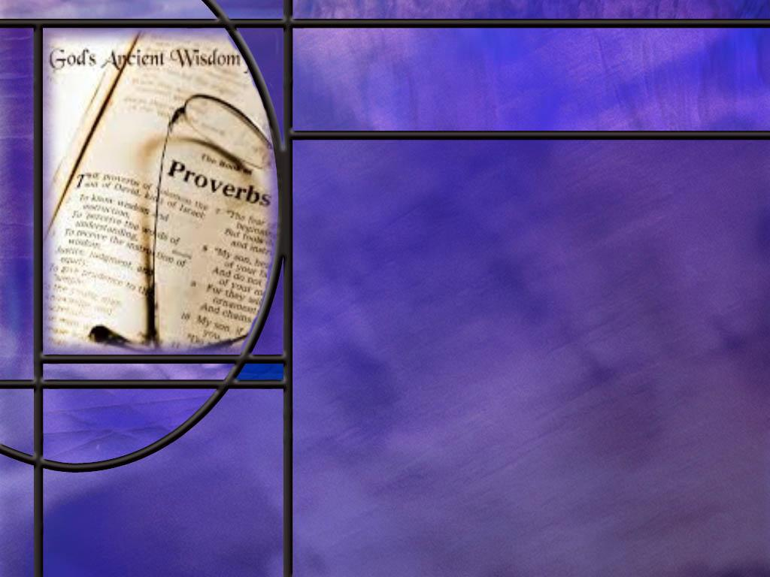
Memory Text
Psalm 90:12 NKJV
So teach us to number our days, That we may gain a heart of wisdom.
In this prayer of Moses, what do you think he means by asking God to “teach us to number our days?”
What is wisdom?
How is the fear of the LORD the beginning of wisdom?
Notes:
B2:
1. This is not a call for God to teach us to remember and celebrate a birthday every year.
2. If we look at the context of this verse, Moses is comparing the immortality of God and His eternal existence to the brevity of man’s existence before death.
3. He starts out by writing:
Psalm 90:2 ESV - 2 … from everlasting to everlasting you are God.
Psalm 90:4-6 NIV - 4 A thousand years in your sight are like a day that has just gone by, or like a watch in the night. 5 Yet you sweep people away in the sleep of death--they are like the new grass of the morning: 6 In the morning it springs up new, but by evening it is dry and withered.
4. God is eternal; we are mortal.
5. We have only a few years upon the stage of life and we are gone.
6. So this is a plea that God would help us to see the brevity of life and appreciate each day and the opportunities is gives us.
7. The NLT paraphrases it this way:
Psalm 90:12 NLT - Teach us to realize the brevity of life, so that we may grow in wisdom.
8. So let’s be thankful for each new day of life.
9. Let us make the most of each day.
10. And let us use each day in a way that will bring glory to God.
B3:
1. Wisdom is the ability to make good decisions that will lead to a successful outcome.
2. Wisdom is different than knowledge.
3. Knowledge is an understanding of the facts based on experience or education.
4. Wisdom is the ability to make good judgments based on knowledge and experience.
5. There is an interesting saying that illustrates the difference:
“Knowledge is knowing that a tomato is a fruit; wisdom is deciding not to put it in a fruit salad.”
B4:
Psalm 111:10 ESV - The fear of the LORD is the beginning of wisdom;…
1. Wisdom is making good decisions in life that will lead to a successful outcome.
2. What would you consider a successful outcome to your life?
3. A life that ends with eternal life in the kingdom of God would have to be considered a success.
4. A life that ends in eternal death in the lake of fire would have to be considered a failure.
5. So the connection is very clear: fearing God, standing in awe of the Lord of scripture and acknowledging Him for who He is as creator, redeemer, sustainer, restorer, and worshipping Him with reverence, adoration and praise is the first step toward accepting His provision for salvation that leads to a successful life.
6. True wisdom is found in a relationship with Jesus as Savior and Lord.
7. In fact, Paul says He is made unto us “wisdom.”
1 Corinthians 1:30 NIV - 30 It is because of him [God] that you are in Christ Jesus, who has become for us wisdom from God--that is, our righteousness, holiness and redemption.
8. So Christ is our “wisdom from God.”
9. Those who have made the decisions that have placed themselves “in Christ Jesus” have made the decisions that will bring them true success in life.
10. And this fits in perfectly to the dilemma that Moses is considering here.
11. When we realize the brevity of our mortal existence, we should be open to God’s wisdom that leads us to eternal life in Jesus Christ.

Slide 3
Overview
The psalms in our lesson this week are didactic psalms that have a lesson to teach to those who read or sing them. The truth they teach is that those who love the Lord and keep His commandments and seek His forgiveness will find true success and blessings for time and eternity.
  The Word of God
  Times of Testing
  Two Paths in Life
  Summary

Slide 4
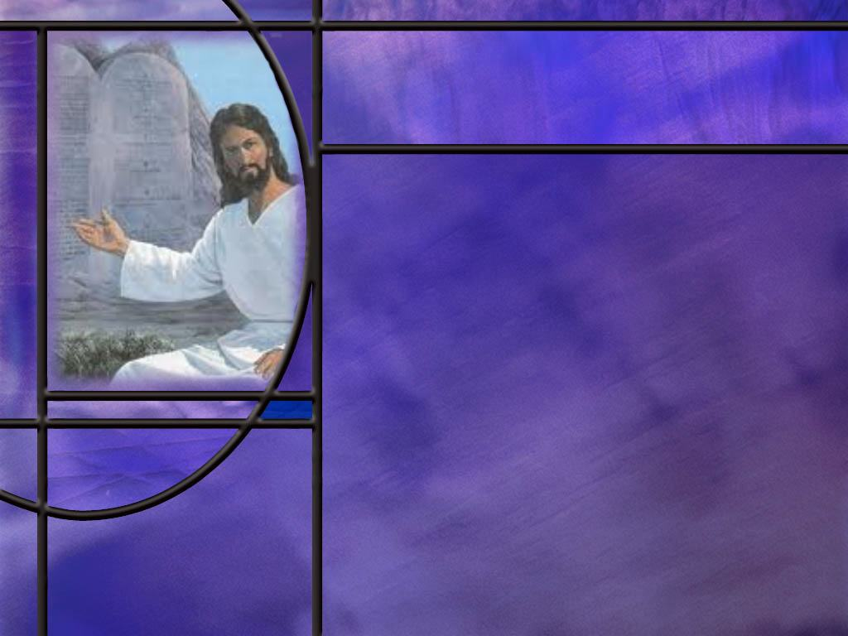
The Word of God
What makes Psalm 119 unique?
What beatitudes begin this unique and wonderful psalm? (Ps 119:1-8)
How does the second stanza build upon the first? (Ps 119:9-16)
What other verses of this psalm are particularly worthy of memorization? (Ps 119:18, 72, 89, 97, 105, 165)
Notes:
B1:
1. It is the longest chapter in the Bible by far.
2. It contains 176 verses.
3. It is divided into 22 sections or stanzas with the first word of each new stanza beginning with the next letter of the Hebrew alphabet: Aleph, Beth, Gimel, Daleth, etc.
4. Each stanza contains eight verses consisting of two lines each.
5. The psalm focuses on the word of God, its importance, and what our response to it should be.
6. Although the central theme of the psalm is the law or the torah, no single commandment from the law of Moses is quoted.
7. Instead it focuses on what our relationship to the revealed word of God should be.
8. So this is a meditation on the law of God, and the giver of the Law, whose character is revealed in His word.
B2:
[See notes on linked slide.]
B3:
[See notes on linked slide.]
B4:
[See notes on linked slide.]

Slide 5
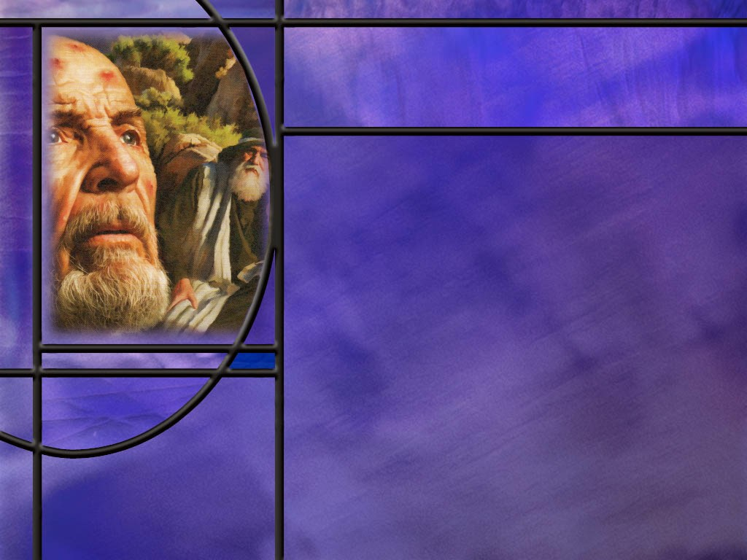
Times of Testing
In recounting God’s acts in history, how does the psalmist describe the time it took Joseph to realize God’s plan for deliverance? (Ps 105:17-21)
How is James explicit in teaching the benefits of trying times? (James 1:2-4)
Notes:
B1:
[See notes on linked slide.]

Slide 6

Two Paths in Life
How does the psalmist describe the path in life that the righteous choose? (Ps 1:1-3)
In contrast to the righteous, how are the wicked described? (Ps 1:4)
What are the destinations to which these two paths in life lead? (Ps 1:5-6)
What did Jesus say about the two ways we could choose and where they lead? (Matt 7:13-14)
What path are most people on and how do they rationalize their choice?
Notes:
B1:
[See notes on linked slide.]
B2:
[See notes on linked slide.]
B3:
[See notes on linked slide.]
B4:
[See notes on linked slide.]
B5:
1. Most people are on the broad way that leads to destruction.
2. Most rationalize it by comparing themselves to others and thinking they’re not so bad.
3. Many don’t take the Bible seriously and find consolation in what modern philosophers teach: there is no objective truth.
4. They think that somehow God is going to grade on the curve, and they hope to make it by the skin of their teeth.
5. They think that when they get old and gray and have one foot in the grave that they will make a deathbed confession.
6. But now they’re having too much fun and they don’t want to give up all the vices in life that they enjoy: drugs, alcohol, sex, entertainment, sports, etc.
7. This is Satan’s greatest deception isn’t it?
8. No need to decide today. There’s always tomorrow. What’s the rush?
9. Eat, drink, and be merry. Have some fun. Enjoy life.
10. There’s no hurry.

Slide 7

Summary
The psalms in our study this week are didactic psalms that teach an inspired lesson.
In Psalm 90, Moses compares our brief lifespan of 70 to 80 years to the immortality of God and prays that God would teach us to number our days, to recognize the brevity of life, and get a heart of wisdom. Wisdom is the ability to make good decisions that lead to a successful outcome.
Ps 111:10 says the fear of the Lord is the beginning of wisdom.
The fear of the Lord is the first step toward accepting His provision for salvation that leads to a truly successful life.
Christ is our “wisdom from God.”

Slide 8
Summary
Psalm 119, the longest chapter in the Bible, is a profound and heartfelt discourse centered on the power, importance, and beauty of God's laws and statutes.
It implores us to immerse ourselves in God's statutes, finding in them a source of hope, strength, and direction.
God’s word is eternal, more precious than silver and gold, brings joy to those who walk in it, keeps us from sin when hidden in our hearts, brings us great peace when we love it and obey it, is a lamp to our feet and a light to our path, and is worthy of constant meditation.
With such an exalted view of the Torah, may we be motivated to spend time in the inspired Scriptures and reap the promised benefits.

Slide 9
Summary
Psalm 1 teaches us the importance of choosing the right path in life.
The path of the righteous is described as shunning the progressive deceptions of sin and delighting in the law of the Lord.
The righteous are described figuratively as trees planted in a well-irrigated orchard bearing fruit; the wicked are described as useless chaff driven away by the wind.
In the end the wicked perish, but the Lord knows the righteous and preserves them.
Jesus also taught that there are only two paths: the narrow leading to eternal life and the wide leading to eternal death.
Knowing the final destiny of these two paths, will you make your choice today to trust the Lord Jesus and live?

Slide 11
Psalm 119:1-8 NIV
1 [Aleph] Blessed are those whose ways are blameless, who walk according to the law of the LORD. 2 Blessed are those who keep his statutes and seek him with all their heart–
3 they do no wrong but follow his ways. 4 You have laid down precepts that are to be fully obeyed.
5 Oh, that my ways were steadfast in obeying your decrees! 6 Then I would not be put to shame when I consider all your commands.
7 I will praise you with an upright heart as I learn your righteous laws. 8 I will obey your decrees; do not utterly forsake me. [R]
Notes:
Q1: Note the beatitudes that begin this psalm? What does it mean to be blessed?
1. To be blessed means to be happy or joyful.
2. The NLT begins this psalm with the words, “Joyful are the people…”
3. With so much depression and sadness in our culture, people’s ears should perk up when they read about how to have joy and happiness.
4. Go to God’s word and find out how to have a joyful, happy, fulfilling life.
Q2: What is it that brings blessing and joy into the lives of God’s children?
1. They walk according to the law of the LORD.
2. They keep His statutes.
3. They are blameless, living in obedience to the law.
4. They seek the Lord with all their heart.
5. If we take these first two verses as a synonymous parallelism, when we seek the Lord with all our heart, we will walk according the law of the Lord.
6. Remember what Jesus said about loving Him and keeping His commandments?
John 14:15 ESV - 15 "If you love me, you will keep my commandments.
Q3: What are some of the different synonyms used in these verses for the word of God?
1. The law of the Lord.
2. His statutes.
3. His ways.
4. His precepts.
5. His decrees.
6. His commands.
7. His righteous laws.
8. In this psalm, these are all synonyms for the word of God, the Torah, the inspired commands and instructions of the Lord.
9. Verses 5 – 8 express the psalmists desire to be steadfast in following God’s instructions.
10. Can we express that same desire?
11. Even though we may fall and come short of full and consistent obedience, that should be our desire.
12. And we can be glad that God will not utterly forsake us because we have full and free forgiveness in the Lord Jesus Christ.

Slide 12
Psalm 119:9-16 NIV
9 [Beth] How can a young person stay on the path of purity? By living according to your word. 10 I seek you with all my heart; do not let me stray from your commands. 11 I have hidden your word in my heart that I might not sin against you. 12 Praise be to you, LORD; teach me your decrees. 13 With my lips I recount all the laws that come from your mouth. 14 I rejoice in following your statutes as one rejoices in great riches. 15 I meditate on your precepts and consider your ways. 16 I delight in your decrees; I will not neglect your word. [R]
Notes:
Q1: What is the psalmist teaching us in these verses?
1. He is teaching us how to live a pure life.
2. He asks a question to get us to think, and he provides us an answer to his question.
3. We can have a life of purity by living according to the word of God.
Q2: What does it mean to hide God’s word in your heart?
1. Perhaps we can think of several levels of meaning here.
2. First is to know and understand God’s word: what does it say and what does it mean, and how should I live in the light of it.
3. Second, to memorize the word of God and hide it in our hearts.
4. When we memorize the Word, it is fixed in our minds, and we don’t have to question it or try to look it up, or quote in incorrectly.
5. Third, it is hid in our hearts, not just in our minds.
6. This would speak of loving the Word and the Giver of the Word.
7. It is a desire to keep the word of God because we love Him, not because we have to.
8. And as we fix the word of God in our hearts, we will know right from wrong and will be able to stay on the path of purity.
Q3: How well did Jesus know the word of God?
1. It is clear that Jesus had memorized scripture.
2. During His ministry, there is never any indication that He needed to pull out a scroll to find a passage.
3. On the road to Emmaus, He “expounded unto them in all the scriptures the things concerning himself.”
4. So clearly, Jesus had memorized all the OT messianic prophecies.
5. And when tempted in the wilderness, He met every temptation with “It is written” and a quotation from the word of God.
6. Again in this passage we see all the synonyms for the word of God: your word, your commands, your decrees, your laws, your statutes, your precepts.
7. There is also a little memory hook that I would like to pass on for remembering the text of Psalm 119:11.
8. The key word in this verse is Hid (Thy word have I hid in my heart.)
9. Think of the text citation, 119:11, as the nine hiding between the two elevens.

Slide 13
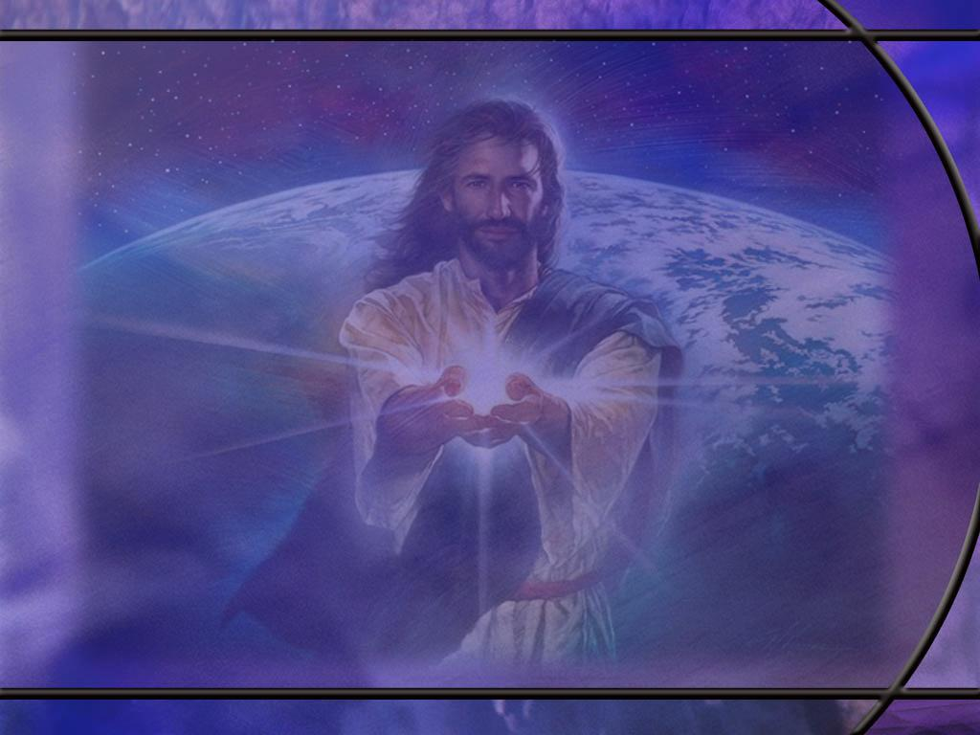
Psalm 119:18, 72, 89, 97, 105, 165 NIV
- 18 Open my eyes that I may see wonderful things in your law. ... 72 The law from your mouth is more precious to me than thousands of pieces of silver and gold. ... 89 Your word, LORD, is eternal; it stands firm in the heavens. ... 97 Oh, how I love your law! I meditate on it all day long. ... 105 Your word is a lamp for my feet, a light on my path. ... 165 Great peace have those who love your law, and nothing can make them stumble. [R]
Notes:
Q1: How does the psalmist view the word of God based on these texts?
1. It is precious to him, of more value that silver and gold.
2. It is eternal, fixed, unchanging.
3. It is the light of truth that dispels the darkness of error.
4. It brings peace and blessing to all those who love it and obey it.
5. It is worthy of day-long meditation.
6. He sees the great value and benefits for successful living in the word of God.
7. How about us?
8. Do we value the word of God as much as these verses indicate we should?
9. What do we meditate on all the day?
10. Chances are we spend way more time on TV than we do in our Bibles.
11. And I am as guilty as anyone.
12. We need to become once more “the people of the book.””

Slide 14
Psalm 105:17-21 NLT
Then he sent someone to Egypt ahead of them--Joseph, who was sold as a slave. 18 They bruised his feet with fetters and placed his neck in an iron collar. 19 Until the time came to fulfill his dreams, the LORD tested Joseph's character. 20 Then Pharaoh sent for him and set him free; the ruler of the nation opened his prison door. 21 Joseph was put in charge of all the king's household; he became ruler over all the king's possessions. [R]
Notes:
Q1: What does this psalm teach about difficult times that God allows us to go through?
1. These times can be a test of our character to strengthen and refine us.
Q2: What difficulties did Joseph go through?
1. Hated by his brothers.
2. Sold into slavery.
3. Accused of sexual assault by Potiphar’s wife.
4. Spent at least 2 years in prison for a crime he didn’t commit.
Q3: How did Joseph do on the character test?
1. When approached by Potiphar’s wife for sex he said:
Genesis 39:9 ESV - How then can I do this great wickedness and sin against God?"
2. He was faithful to God.
3. God’s timing is not our timing.
4. But God was always blessing Joseph and moving him along in the right direction.
5. He became the prison manager.
6. God gave him the interpretation of the baker and cup bearer’s dreams.
7. And when the time came of the years of plenty, he was 30 years old and ready to take on the responsibility of saving the lives of many, even his own family.
8. He could see the hand of God in all that happened.
9. Speaking to his brothers, he said:
Genesis 50:20 ESV - 20 As for you, you meant evil against me, but God meant it for good, to bring it about that many people should be kept alive, as they are today.
10. God may use discipline in our lives too to strengthen us and prepare us to fit into His plans.

Slide 15
James 1:2-4 ESV
Count it all joy, my brothers, when you meet trials of various kinds, 3 for you know that the testing of your faith produces steadfastness. 4 And let steadfastness have its full effect, that you may be perfect and complete, lacking in nothing. [R]
Notes:
Q1: How does God use the testing times that He allows?
1. He uses them to refine our characters, to strengthen our faith, and make us mature Christians that will be able to endure unto the end.

Slide 16
Psalm 1:1-3 ESV
Blessed is the man who walks not in the counsel of the wicked, nor stands in the way of sinners, nor sits in the seat of scoffers; 2 but his delight is in the law of the LORD, and on his law he meditates day and night. 3 He is like a tree planted by streams of water that yields its fruit in its season, and its leaf does not wither. In all that he does, he prospers. [R]
Notes:
1. This psalm starts out by describing three things that the righteous do not do.
2. Blessed is the man who walks not…
3. Again, the blessed man is the one who is joyful and happy and at peace.
Q1: How does verse 1 present the progressive nature of sin?
1. We start out walking with the wicked, then standing with sinners, then finally sitting with the scoffers, having reached a condition where we are settled into rejection of God and His truth.
2. When we are walking, it is not hard to separate and go a different direction.
3. When we are standing, it is a little harder to overcome the inertia and walk away.
4. And when we’re sitting we have settled down into the easy chair of sin and it’s hard to get up.
5. We end up with the scoffers, that are not just content to reject God on their own, but scoff at, and make fun of, the righteous and their God.
6. Sin is progressive, and unless we deal with it quickly, it becomes more and more enslaving.
7. And before we know it, we have turned our back on the Lord and His grace.
Q2: In contrast to delighting in sin, in what does the righteous delight?
1. He delights in the law of the LORD, and he meditates on it day and night.
2. Now when we think of the law of the Lord, many think of just the 10 commandments.
3. But the Hebrew used here is torah which means instruction or precept and refers to the entire written revelation of God’s will.
4. The inspired word of God: OT and NT is our Torah.
5. Happy is the man who loves God’s word!
6. Want to be happy? Shun sin and meditate on the word of God.
Q3: What does the psalmist say is the result of choosing the righteous life?
1. Verse 3 describes him as being planted by the streams of water.
2. Before I studied this verse, I thought that this tree just came from a seed that happened to fall on the river bank and grew up there.
3. But the action here is much more intentional.
4. The tree is planted, and the Hebrew word used there means transplanted.
5. And this is not just a river that happens to be flowing by.
6. The tree is transplanted between streams (plural).
7. And the Hebrew word for these streams (peh’leg) means in irrigation ditch or canal.
8. So here we have the Master Gardner transplanting the tree to a place in the orchard that He’s carefully prepared.
9. It is a place where it can get sunshine, water, nourishment, and bear fruit.
10. And because it’s roots are well watered, the tree will not wither when the heat of trials and tribulations come along.
11. So if you choose the way of the righteous, God’s plan is to plant you in the orchard of His church so that you can bear fruit for His kingdom.
12. The fruit we bear for the kingdom of God shall not wither.
13. Our influence for good in the lives of others can have eternal consequences.

Slide 17
Psalm 1:4 ESV
The wicked are not so, but are like chaff that the wind drives away. [R]
Notes:
Q1: What is chaff?
1. Chaff is the hull that grows around the kernel of wheat.
2. When they thrashed the wheat in Israel, they would throw it up in the air, and the wind would blow away the lighter chaff and the kernels of wheat would fall back to the threshing floor.
3. The chaff was good for nothing; it was a nuisance to be gotten rid of.
4. In contrast to the tree that was living, the chaff was dead; it had no root and bore no fruit.

Slide 18
Psalm 1:5-6 ESV
Therefore the wicked will not stand in the judgment, nor sinners in the congregation of the righteous; 6 for the LORD knows the way of the righteous, but the way of the wicked will perish. [R]
Notes:
Q1: What is the bad news for those who have chosen to reject God and rebel against His word?
1. Judgment is coming!
2. And this psalm says that that the wicked will not stand in the judgment.
3. They will be condemned by their sins.
4. There will be two groups, the wicked and the righteous, and God will separate them like the sheep from the goats.
5. The Lord knows them that are His, and this will become evident when Jesus returns in glory.
Q2: What makes the righteous “righteous” if they too have sinned? Is it just a matter of degrees? How can anyone claim to be righteous when the Bible says all have sinned and come short of the glory of God?
1. Our only claim to righteousness is through the forgiveness of sin.
2. It is accepting the grace of God by faith.
3. It is trusting in the shed blood of Jesus to cover our sins and give us His righteousness.
1 John 1:9 ESV - 9 If we confess our sins, he is faithful and just to forgive us our sins and to cleanse us from all unrighteousness.
4. That is the only way anyone can be come righteous.
5. When the wicked refuse the grace of God and refuse to confess their sins, they bear their own sins in the judgment.
6. By contrast, Christ bears the sins of the righteous, and His righteousness is placed to our account.
Romans 8:1 ESV - There is therefore now no condemnation for those who are in Christ Jesus.
Q3: What is the end result for the righteous and the wicked.
1. First we see the final destiny of the wicked: they will perish.
2. They will be destroyed and be no more.
3. The wages of sin is death, eternal death.
4. So the end result for the righteous must be the opposite of that.
5. The opposite of eternal death is eternal life.
6. That is the implied destiny of the righteous in this psalm.
7. This final verse says the Lord knows the way of the righteous.
8. He knows us; He knows our hearts; He knows all about us; He loves us.
9. The implication of the Lord knowing the way of the righteous is that the righteous have a loving, saving relationship with Him.
10. So God gives us the freedom to make the choice of which path to follow.
11. One path leads to eternal death, the other to eternal life.
12. I am reminded of the words of Moses
Deuteronomy 30:19 ESV - I call heaven and earth to witness against you today, that I have set before you life and death, blessing and curse. Therefore choose life, that you and your offspring may live,
13. And I am also reminded of Joshua’s confession:
Joshua 24:15 ESV – … But as for me and my house, we will serve the LORD.“

Slide 19
Matthew 7:13-14 ESV
"Enter by the narrow gate. For the gate is wide and the way is easy that leads to destruction, and those who enter by it are many. 14 For the gate is narrow and the way is hard that leads to life, and those who find it are few. [R]
Notes:
Q1: How many gates did Jesus say you could choose to enter?
1. Just two: the narrow gate or the wide gate.
Q2: Where do they lead?
1. The narrow gate and the hard path lead to life; the wide gate and the easy path lead to destruction.

