Slide 1
The Great Controversy
Lesson 2
The Central Issue: Love or Selfishness

Slide 2
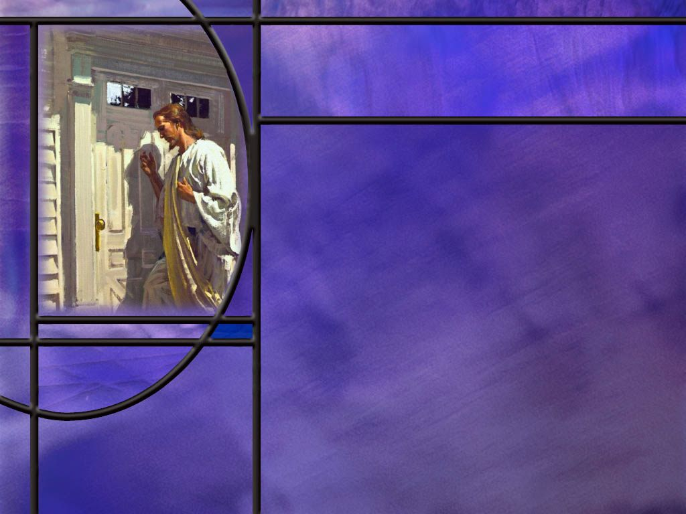
Memory Text
Isaiah 41:10 NKJV
Fear not, for I am with you; Be not dismayed, for I am your God. I will strengthen you, Yes, I will help you, I will uphold you with My righteous right hand.’
To whom do you think these wonderful words of promise were spoken?
Who are the descendants of Abraham today?
Where does God place Himself in relation to His people?
What does God promise to do for His people in this verse?
Notes:
B2:
1. If we go back to the two previous verses, we see that they were spoken to God’s chosen people, Israel.
2. In fact, Isaiah gives three unmistakable identifiers.
3. Here is what verse 8 of chapter 41 says:
Isaiah 41:8 ESV - 8 But you, Israel, my servant, Jacob, whom I have chosen, the offspring of Abraham, my friend;
4. So God’s promises here are spoken to the descendants of Abraham, the children of Israel (also called Jacob): God’s chosen people in the time of Isaiah.
B3:
1. The true descendants of Abraham today are all those who have accepted the Messiah and His salvation by grace through faith.
2. Paul writes in:
Galatians 3:29 ESV - 29 And if you are Christ's, then you are Abraham's offspring, heirs according to promise.
3. In Gal 6:16 Paul calls all of the Christians who receive his message “the Israel of God.”
4. To the Romans he writes in
Romans 2:28-29 KJV - 28 For he is not a Jew, which is one outwardly; … 29 But he is a Jew, which is one inwardly.
5. And he writes in Romans 11 about the wild olive branches being grafted into the olive tree, which represents God’s chosen people, and so “all Israel will be saved.” (Rom 11:26)
6. So if these are God’s promises to Israel, we, as spiritual Israel, can claim these promises today.
B4:
1. He starts this verse by saying, “Fear not, for I am with you.”
2. Our God is not far from any one of us. He is the immanent God.
3. In fact, we are the temples of His Holy Spirit.
4. He leads us and guides us and lives right inside us.
5. So these promises are for those who have a living, loving relationship with the Lord, and are filled with the Holy Spirit.
B5:
1. He wants to comfort us so that we will not fear or be dismayed
2. He promises to strengthen us and help us and uphold us.
3. What a Friend we have in Jesus!!!
4. There is nothing that can separate us from His love.
5. His final promise in the book of Matthew is “Lo I am with you always, even to the end of the age.”
6. No matter what He allows us to go through, we can know that He is always there encouraging us to bear our trials as He bore His.
7. The writer to the Hebrews wrote that we should:
Hebrews 12:2 KJV - Look[ing] unto Jesus the author and finisher of our faith; who for the joy that was set before him endured the cross, despising the shame, and is set down at the right hand of the throne of God.
8. If Jesus endured the cross for the joy of being with us for eternity, we can endure the light affliction of this life for the joy of being there with Him.
9. Until the GC is finished and Christ reigns victoriously, we will have many trials and temptations and battles to fight.
10. But we have the omnipotent God who promises to help us and uphold us and strengthen us.
11. Does it make sense to claim that promise? (Absolutely!)

Slide 3
Overview
The GC between good and evil plays out on earth through the entire biblical timeline from Eden lost to Eden restored. Although many of the Jewish people rejected their Messiah, God established, protected, and blessed a remnant to proclaim the everlasting gospel of salvation by grace through faith.
  Signs of the Times
  Abomination of Desolation
  New Remnant in Christ
  Summary

Slide 4
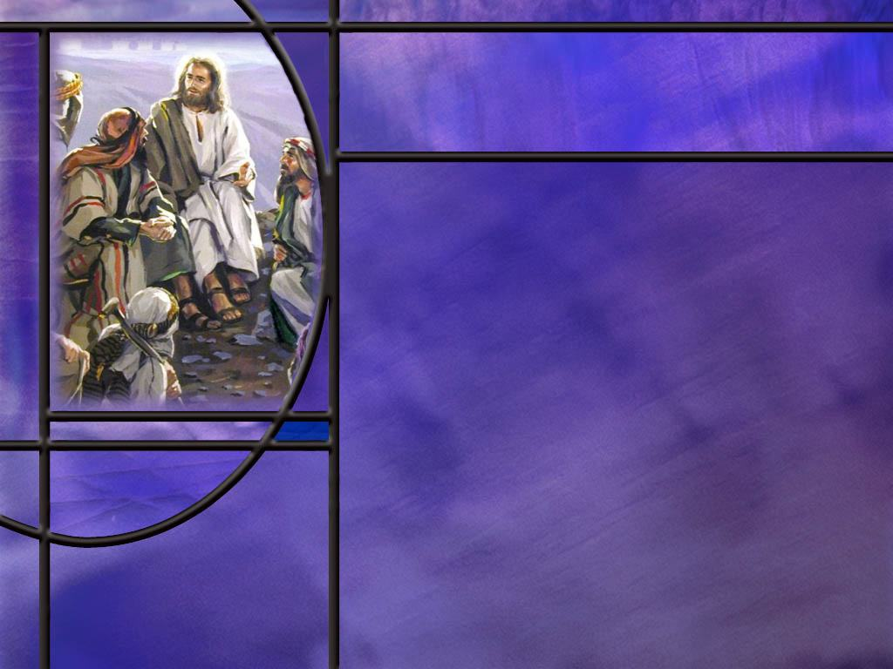
Signs of the Times
What did Jesus predict about the temple in Jerusalem? (Matt 24:1-2)
What questions did the disciples ask in response? (Matt 24:3)
Why was Jerusalem to be destroyed? (Luke 19:43-44)
What were some of the signs that Jesus gave?
When and how were the words of Jesus concerning the temple fulfilled?
Notes:
B1:
[See notes on linked slide]
B2:
[See notes on linked slide]
B3:
[See notes on linked slide]
B4:
1. False Christs and false prophets deceiving many, wars and rumors of war, famines, pestilences, earthquakes, tribulation, hatred, and death for Christians, apostasy, betrayal, hatred, lawlessness.
2. But then Jesus says,
Matthew 24:13 (NKJV)
¹³ But he who endures to the end shall be saved.
3. Apparently Jesus never heard of the health and wealth gospel preached by some TV preachers today.
4. For His disciples in the 1st century and for many down through the ages, Jesus predicts tribulation.
5. But He encourages us to “hold on.” Salvation’s coming!
B5:
1. In 70 AD, the Roman general Titus laid siege to Jerusalem in the spring of the year when it was full of people who had come to celebrate the Passover.
2. By August, the people were starving to death and fighting gangs for scarce resources.
3. Josephus (a Jewish historian) records that one starving mother ate her baby.
4. The Jews refused to surrender, thinking that God would yet deliver His temple.
5. The Romans eventually set fire to the gold plated walls of the temple and burned the city to the ground.
6. Josephus claims that 1.1 million people were killed during the siege, of which a majority were Jewish, and that 97,000 were captured and sold into slavery, some in Egypt.
7. His numbers are disputed by modern scholars, but virtually everyone in the city was either killed or enslaved.
8. Others estimate the Jewish losses at a quarter million.
9. The gold in the temple melted with the heat and ran into the cracks between the stones.
10. It is no wonder then that the stones were all removed by those looking for gold.

Slide 5
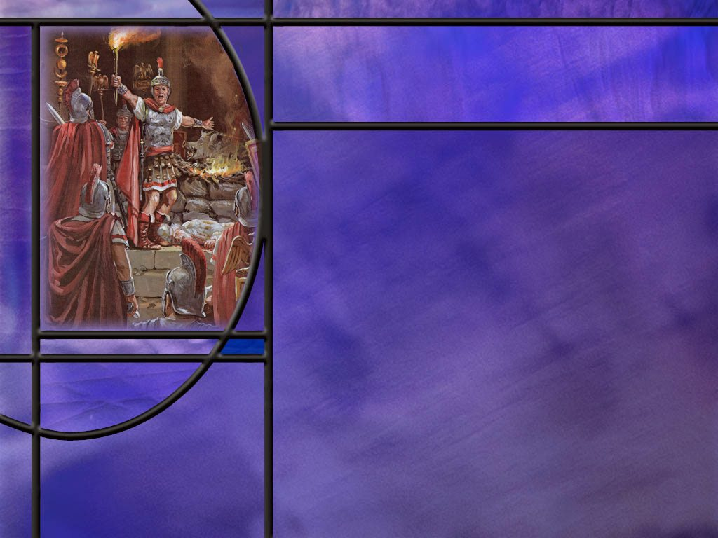
Abomination of Desolation
How does Daniel describe the abomination of desolation? (Dan 9:26-27)
How do Matthew and Luke describe the abomination of desolation? (Matt 24:15-20, Luke 21:20-21)
How did Jesus’ warning in Matthew 24 save the Christians in Jerusalem?
Notes:
1. Daniel mentions the abomination of desolation three times in his book (chapters 9, 11, and 12).
2. This first reference in chapter 9 is obviously to pagan Rome, and this is the one to which Jesus refers, because it deals directly with the destruction of Jerusalem and the temple.
3. It is in this same prophecy that Daniel mentions the Messiah and predicts the exact year of His baptism.
4. The last two references to the abomination of desolation come much later in history and are fulfilled by papal Rome.
5. Pagan Rome desolated the sanctuary in Jerusalem.
6. Papal Rome desolated the sanctuary in heaven and the high priestly ministry of Jesus by substituting a false sacrifice, a false priesthood, a false head of the church, and a false way of salvation.
B1:
[See notes on linked slide]
B2:
[See notes on inked slide.]
B3:
1. Before Titus began his siege in 70 AD, there was a Roman governor of Syria (which included Judea) named Cestius Gallus.
2. He marched 2 legions of soldiers (6,000 each) and other militia from Antioch to Jerusalem.
3. The Jews had refused to pray for the emperor of Rome which was considered treason.
4. Cestius Gallus arrived in Rome in 66 AD to restore prayers for the emperor.
5. After less than a week of fighting the Jewish resistance and almost winning, he withdrew and headed back to Antioch.
6. Josephus, the Jewish historian writes:
“Had he[Cestius Gallus] but persisted for a while with the siege [of the temple complex], he would have forthwith taken the city.”
7. The disciples took this short siege by Cestius Gallus in 66 AD as the sign that Jesus gave concerning Jerusalem.
8. Jesus warned them that when they saw the Roman armies surround Jerusalem to head for the hills.
9. Immediately after Cestius Gallus withdrew, the Christians left Jerusalem and established their headquarters in Pella, in the hill country southeast of the sea of Galilee, in the region of the Decapolis.
10. In God Cares Vol 2, Mervyn Maxwell makes this statement:
“Not a single Christian Jew, mother, father, or child, is known to have died in the terrible death of Jerusalem.”

Slide 6
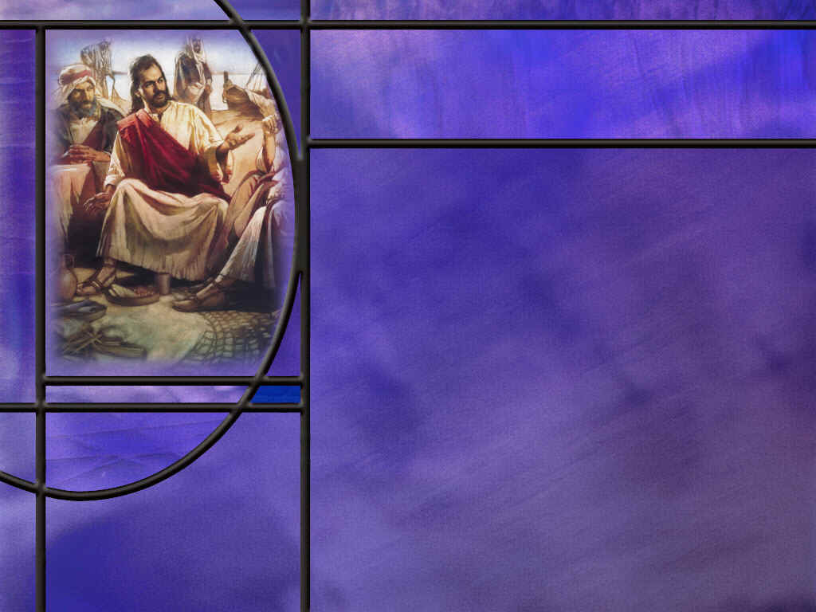
New Remnant in Christ
How big was the remnant that began the Christian church on the day of Pentecost?
How does Paul contrast the remnant with the totality of ethnic Israel? (Rom 9:27)
How did Luke document the explosive growth of the early church? [Church]
What characteristic did Jesus point to as the hallmark of those who would be His disciples. (John 13:35)
How did love for one another manifest itself in the early church? (Acts 2:44-47)
How is fellowship beneficial to keeping our church going and growing for the Lord?
Notes:
B1:
1. From Acts 1:14-15 we know the company in Jerusalem on the day of Pentecost was about 120 in the upper room.
2. But this was just in Jerusalem.
3. There must have been believers in other parts of Israel.
4. Much of Jesus’ ministry was in Galilee, around Capernaum and the Sea of Galilee.
5. The 12 disciples and many of His other disciples were from that region.
6. Paul mentions in 1 Cor 15 that after the resurrection:
1 Corinthians 15:6 ESV - 6 Then he appeared to more than five hundred brothers at one time, most of whom are still alive, though some have fallen asleep.
7. These brethren are presumably believers and eyewitnesses of the risen Lord.
8. So the remnant that Jesus established during His ministry was at least hundreds if not thousands.
9. The great majority of these early believers would be Jews who accepted Jesus as the long-awaited Messiah.
B2:
[See notes on linked slides.]
B3:
[See notes on linked slides.]
B4:
[See notes on linked slides.]
B5:
[See notes on linked slide.]
B6:
1. There is a sense of belonging that is nurtured through fellowship.
2. That sense of belonging is very important in keeping us faithful in the Lord’s work.
3. When we are baptized, we are not just baptized into Christ, we are also baptized into a particular church.
4. It is within the church that God has given us gifts designed to build it up.
5. We function best in our mission when we are working together.
6. There is a story told of a pastor who was visiting a delinquent church member who had neglected worship for several months. The pastor pulled his chair up beside the fireplace, and without saying a word, got up, took the poker, and moved one of the logs to the side. He sat down again without saying a word. As both men watched, the separated log dimmed and lost it’s flame, smoldering by itself. As the pastor got up to leave, the parishioner thanked him for his fiery, but silent, sermon and promised to be at the next worship service.
7. So too with us.
8. Our flame burns brightest when we are connected to other Christians in the body of Christ.
9. We don’t have to live together in a commune, but we should place a high priority on fellowship with each other.
10. Let’s not miss an opportunity to be together at worship, Sabbath School, pot luck, and social events that come along.
11. When we know of a need, let’s see how we can pull together and help.
12. Don’t be afraid to call each other or text each other.
13. And above all, let’s pray for each other.

Slide 7

Summary
Shortly after entering Jerusalem as King and cleansing the temple, Jesus denounced the scribes and Pharisees for their hypocrisy and self-righteousness: their religious façade could not cover the fact that they were plotting to murder the Son of God.
Jesus lamented over Jerusalem because they were “not willing” to be gathered into His Kingdom. For rejecting their Messiah, their house would be left “desolate.”
In answer to His disciples’ questions Jesus intertwined the signs of two events: the destruction of Jerusalem and His second coming at the end of the age.

Slide 8
Summary
The preeminent sign of the destruction of Jerusalem was the abomination of desolation: Roman armies surrounding Jerusalem.
When this occurred in 66 AD, Christians in Jerusalem obeyed their Lord’s warning and fled to the hill country in Pella, escaping the destruction of the city and its inhabitants in 70 AD.
Apparently there are rules of engagement in the GC that prevent one side from completely dominating the other, so strategic decisions must be made as to which battles must be won to lead to ultimate victory.
In rescuing His church from the desolating evil of the devil, God preserved its witness.

Slide 9
Summary
The sacrificial system ceased its significance when Christ died for our sins.
In rejecting the Messiah, ethnic Israel has forfeited her special position as God’s chosen people, and God is now working through all those who have accepted Jesus a Savior and Lord.
As God’s Holy Spirit was poured out at Pentecost, the church took root and grew with divine power as believers shared the gospel with boldness and created a loving community that supported each other.
While Satan did his best to stamp out the church using Roman persecution, the church survived and thrived.
Will you pray for the Holy Spirit to fill you this week and give you a holy boldness to share the gospel like the early church?

Slide 11
Matthew 24:1-2 (NKJV)
Then Jesus went out and departed from the temple, and His disciples came up to show Him the buildings of the temple. ² And Jesus said to them, “Do you not see all these things? Assuredly, I say to you, not one stone shall be left here upon another, that shall not be thrown down.” [R]
Notes:
Q1: What was Jesus’ prediction concerning the temple?
1. It would be destroyed.
2. There would not be one stone left upon another.
Q2: But don’t we see Jews today at the wailing wall praying?
1. Yes, but the wailing wall was not part of the edifice of the temple.
2. It was a retaining wall that was part of the western wall of the temple mount.
3. It was used to provide a flat area on which the temple buildings were built.
4. Today the Dome of the Rock, a Muslim mosque occupies the site of Herod’s temple in Jerusalem.
5. However, there is some conjecture that this may not be the exact location.
6. In any case, nothing of the original temple buildings remains in Jerusalem.
7. Jesus’ prediction is absolutely true: “not one stone will be left upon another.”

Slide 12
Matthew 24:3 (NKJV)
³ Now as He sat on the Mount of Olives, the disciples came to Him privately, saying, “Tell us, when will these things be? And what will be the sign of Your coming, and of the end of the age?” [R]
Notes:
Q1: When shall these things be? What things?
1. Obviously the destruction of the temple that Jesus predicted in the previous verse.
2. Note that the disciples ask two questions here.
3. Apparently they thought the destruction of the temple would be at the end of the age.
4. But they intertwine two questions: the destruction of the temple and the second coming of Jesus.
5. So, in His response, Jesus intertwines these two subjects as well.
6. This makes it sometimes difficult for us to understand what words apply to what subject.
7. But here Jesus is using the destruction of Jerusalem as a type of the destruction that will accompany His second coming.

Slide 13
Luke 19:43-44 (ESV)
For the days will come upon you, when your enemies will set up a barricade around you and surround you and hem you in on every side ⁴⁴ and tear you down to the ground, you and your children within you. And they will not leave one stone upon another in you, because you did not know the time of your visitation."[R]
Notes:
Q1: What central fact of history had Jerusalem missed?
1. Jerusalem would be leveled because they did not know the time of their visitation.
2. In other words, Jerusalem as a whole had rejected the Messiah, Emmanuel, God with us.
3. They had rejected Jesus the Son of God and their Savior from sin.
4. In ending His discourse to the scribes and Pharisees in Matt 23, Jesus says this:
Matthew 23:37-38 (NKJV)
³⁷ “O Jerusalem, Jerusalem, the one who kills the prophets and stones those who are sent to her! How often I wanted to gather your children together, as a hen gathers her chicks under her wings, but you were not willing! ³⁸ See! Your house is left to you desolate;
5. They were “not willing” to be gathered into Christ’s kingdom.
6. The shekinah glory was gone from the temple. Their house was desolate.
7. The temple services had no meaning since their types had been fulfilled by Jesus.
8. The temple veil had been torn for top to bottom.
9. The Jewish temple was no longer the house of God.
10. This destruction of Jerusalem is also a type of the destruction at the second coming and for the same reason.
11. As the Jews had rejected their Messiah, so the world has rejected theirs.
12. Those who are destroyed in the end have rejected the gospel of salvation in Jesus Christ.
13. Paul describes a time…
2 Thessalonians 1:7-9 (NKJV) …when the Lord Jesus is revealed from heaven with His mighty angels, ⁸ in flaming fire taking vengeance on those who do not know God, and on those who do not obey the gospel of our Lord Jesus Christ. ⁹ These shall be punished with everlasting destruction from the presence of the Lord and from the glory of His power,

Slide 14
Daniel 9:26-27 (NKJV)
²⁶ “And after the sixty-two weeks Messiah shall be cut off, but not for Himself;
  And the people of the prince who is to come
  Shall destroy the city and the sanctuary.
  The end of it shall be with a flood,
  And till the end of the war desolations are determined.
²⁷ Then he shall confirm a covenant with many for one week;
But in the middle of the week
He shall bring an end to sacrifice and offering.
  And on the wing of abominations shall be one who makes desolate,
  Even until the consummation, which is determined,
  Is poured out on the desolate.” [R]
Notes:
[Explain structure before reading.]
1. This is part of the 70 week prophecy of Daniel that covered 490 literal years (457 BC to 34 AD).
2. It is written in Hebrews poetry, and there is a beautiful chiastic structure to it.
3. I wish we had time to go into it in detail, but we can only scratch the surface.
4. In the slide here I have divided it into four sections that alternate back and forth between the Messiah and the desolator prince.
5. The bold lines contain the word “week” or “weeks” and refer to the Messiah.
6. The indented italicized lines contain the Hebrew root word for “cut” and refer to the desolator prince.
7. The sections that refer to the desolator prince describe construction or destruction of Jerusalem and the temple.
[Read slide here]
8. At the time of Jerusalem’s destruction, Titus was a prince who later became emperor of the empire.
9. The Abomination of Desolation is referred to in the last half of verse 27.
10. “And on the wing of abominations shall be one who makes desolate.”
11. Titus was the one who made Jerusalem and the temple desolate.
12. It happened just as Jesus said, “your house shall be left to you desolate.”
13. The desolator prince, Titus, is poetically pictured here as being carried along on the wing of abominations.
14. Of course, Titus and his Roman legions were pagan, so their idolatry was an abomination to God.
15. In fact, Josephus records that the Romans set up their standards in the temple and sacrificed to them. (GC2, p 30)
16. This prophecy in Daniel 9 allows us to see the GC in action.
17. These verses alternate back and forth between the Messiah and His work of salvation and the desolator prince and his work of destruction.
18. Christ is cut off, not for His sins but for ours.
19. Satan uses Titus to destroy the city and the sanctuary.
20. Christ brings an end to the sacrificial system in the middle of the 70th week.
21. Satan uses Titus to make the former house of God desolate.
22. Christ inaugurates a new covenant; Satan destroys the vestiges of the old.
23. Here we see both sides at work in the GC, and each side winning their chosen battles.
24. So we conclude that there must be rules of engagement in this cosmic conflict.
25. Neither side totally defeats the other.
26. Both sides must strategically decide which battles they will focus on and win.
27. As we see in these verses, Christ is focused on saving us; Satan is focused on destroying those he can.

Slide 15
Matthew 24:15-20 (NKJV)
¹⁵ “Therefore when you see the ‘abomination of desolation,’ spoken of by Daniel the prophet, standing in the holy place” (whoever reads, let him understand), ¹⁶ “then let those who are in Judea flee to the mountains.
Notes:
[Go to next slide.]

Slide 16
Luke 21:20-21 (NKJV)
²⁰ “But when you see Jerusalem surrounded by armies, then know that its desolation is near. ²¹ Then let those who are in Judea flee to the mountains, let those who are in the midst of her depart, and let not those who are in the country enter her. [R]
Notes:
1. Since Rome was in power, the only army that could surround Jerusalem was the Roman army.
2. So the Roman army in Luke is parallel to the abomination of desolation in Matthew.

Slide 17
Romans 9:27 ESV
And Isaiah cries out concerning Israel: "Though the number of the children of Israel be as the sand of the sea, only a remnant of them will be saved. [R]
Notes:
1. So here we see the contrast between ethnic Israel which encompasses all the descendants of Abraham, and spiritual Israel.
2. Spiritual Israel, whether Jew or Gentile, has a saving relationship with the Lord Jesus Christ which marks them as the remnant that will be saved.

Slide 18
Early Church Growth in Acts
Acts 2:41 ESV - So those who received his [Peter’s] word were baptized, and there were added that day about three thousand souls.
Acts 2:47 ESV - And the Lord added to their number day by day those who were being saved.
Acts 4:4 ESV - But many of those who had heard the word believed, and the number of the men came to about five thousand.
Acts 5:14 ESV - And more than ever believers were added to the Lord, multitudes of both men and women,
Acts 6:7 ESV - And the word of God continued to increase, and the number of the disciples multiplied greatly in Jerusalem, and a great many of the priests became obedient to the faith. [R]
Notes:
Q1: Why do you think the church grew with such leaps and bounds in the early days?
1. The gospel went forward under the mighty power of the Holy Spirit in the early rain.
2. There were signs and wonders that accompanied the gospel: people were healed and delivered, miracles occurred, Dorcas was raised from the dead.
3. Eyewitnesses of the risen Lord were convinced of the truth of the resurrection.
4. They couldn’t help but proclaim what they had seen and heard.
5. The resurrection made them fearless of persecution and death and gave them a hope that they had to share.
6. When the apostles were forbidden to speak in the name of Jesus under threat of punishment and imprisonment they replied:
Acts 4:19-20 ESV - "Whether it is right in the sight of God to listen to you rather than to God, you must judge, 20 for we cannot but speak of what we have seen and heard.“
7. The HS gave them a holy boldness to share the gospel regardless of consequences.
8. They were focused on the things above rather than on the things of earth.
9. We would do well to emulate their zeal and focus.

Slide 19
John 13:35 ESV
By this all people will know that you are my disciples, if you have love for one another." [R]
Notes:
Q1: According to Jesus, what should be the identifying mark of His disciples?
1. There should be a special bond of love between fellow Christians.
2. It should be a love that reflects the love within the Godhead.
3. That kind of love is supernatural love; it’s agape love; it’s love that puts others first; it’s an unconditional love.
4. Seeing love in action has a powerful influence for truth.
5. And that kind of love will convince the world that God is love and Jesus is love and the word of God is true.
6. You can’t love God and hate your brother.
7. If you love God you will keep His commandments, and one of His commandments is “love one another.”
8. That commandment comes in the verse right before this one.
John 13:34 KJV - 34 A new commandment I give unto you, That ye love one another; as I have loved you, that ye also love one another.
The apostle Paul wrote to the Corinthians in:
1 Corinthians 16:14 ESV - Let all that you do be done in love.

Slide 20
Acts 2:44-47 ESV
And all who believed were together and had all things in common. 45 And they were selling their possessions and belongings and distributing the proceeds to all, as any had need. 46 And day by day, attending the temple together and breaking bread in their homes, they received their food with glad and generous hearts, 47 praising God and having favor with all the people. And the Lord added to their number day by day those who were being saved. [R]
Notes:
Q1: What kind of fellowship do we see in these verses?
1. This seems to imply that they are one big happy family.
2. Luke says they were all together.
3. That implies that they lived together, although you could say they were all together in spirit instead of physically.
4. They shared everything in common.
5. They sold their possessions and goods and took care of everyone.
6. This appears to be communal living.
Q2: Do you think that kind of arrangement would work in our culture?
1. Communal living has never worked out well in practice.
2. This is a form of socialism which provides little incentive to work.
3. As Margret Thatcher once commented on socialism: “"The trouble with Socialism is that eventually you run out of other people's money.“
4. My own opinion is that this communal living was only a temporary arrangement that was necessary for those who were baptized on the day of Pentecost.
5. Acts tells us that many of the 3,000 were from foreign countries, many were from other parts of Judah, some, we assume, were also from Jerusalem.
6. In the Great Commission, Jesus told us to make disciples, baptize them, and teach them “to observe all that I have commanded you.”
7. Apparently that was what was happening here.
8. They were attending the temple for instruction day by day and they were breaking bread together in the homes of fellow believers.
9. Many of the new converts would not have a job in Jerusalem and they would have to depend on the generosity of those who lived there.
10. I presume that when their instruction was completed they would be going back to their own homes to care for their own families.

